Slide 1
Holmusk Senior Data Scientist Technical Task
Rose Sisk, PhD
26/01/2024

Slide 2

Research question
What proportion of patients presenting to emergency or inpatient care with Major Depressive Disorder are receiving the current treatment standard?
Which factors are associated with meeting the treatment standard?

Slide 3







Data summary
Demographics
Clinical data
3000
3000
Unique patients
Unique patients
3400
Admissions
First admission per pt retained
Gender (M/F)
Ethnicity,
residency status
Current treatments
Medical history, comorbidities, severity

Slide 4



Methods
Retrospective
cohort study
3000
Unique
patients
Emergency & inpatient episodes
2011-2015
Create composite outcome
Summarise data
Identify associated factors
Treated with antidepressants (including SSRIs)
N (%)
Logistic regression model
Categorical variables
Mean
(SD)
Patient and clinical predictors
Continuous variables
Treated with therapy
Visualise results via forest plot
Overall & by treatment standard

Slide 5
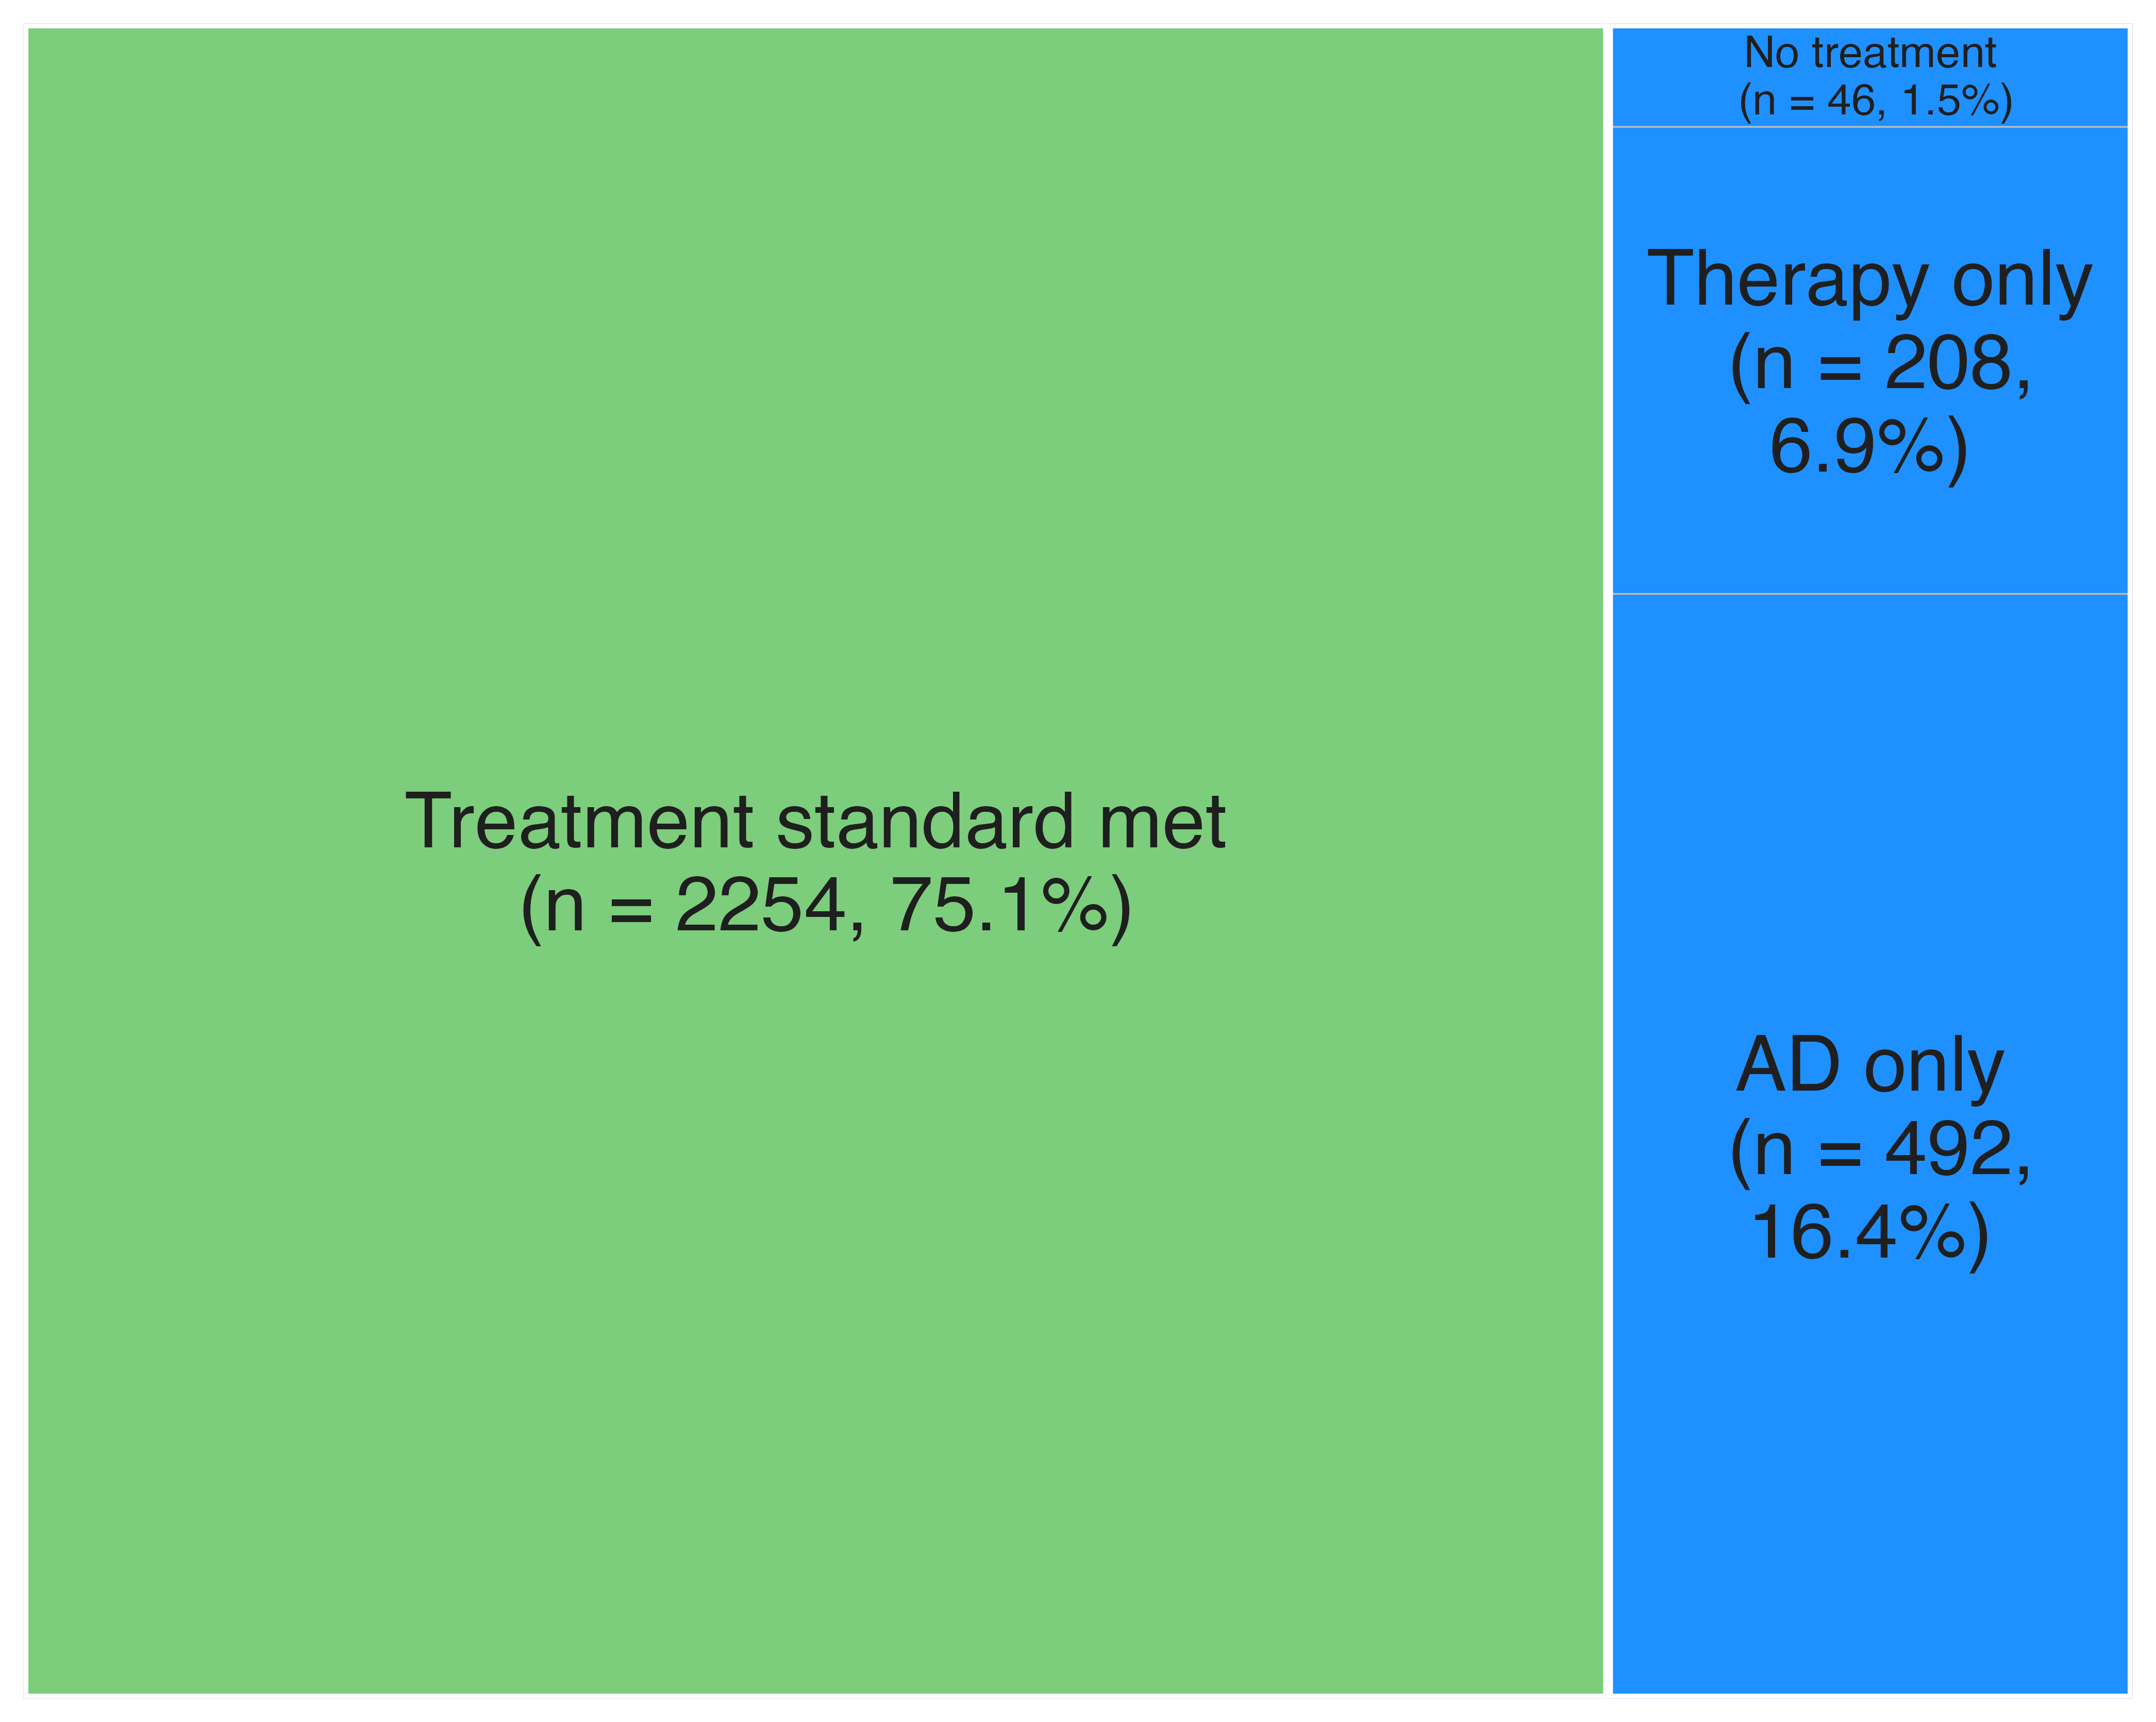
Results
Therapy
 | No | Yes
No | 46 | 208
Yes | 492 | 2254
Antidepressants (AD)
Figure 1: Treemap of treatment standard categories
Table 1: Contingency table of treatment standard categories

Slide 6
Results
Characteristic | Overall, N = 3,000¹ | Treatment Standard Met
 |  | No, N = 746 (25%)¹ | Yes, N = 2254 (75%)¹
Age at admission | 52 (15) | 52 (15) | 52 (15)
Gender
Female | 1,497 (50%) | 357 (48%) | 1,140 (51%)
Male | 1,503 (50%) | 389 (52%) | 1,114 (49%)
Race
Chinese | 1,915 (64%) | 482 (65%) | 1,433 (64%)
Indian | 295 (9.8%) | 74 (9.9%) | 221 (9.8%)
Malay | 629 (21%) | 145 (19%) | 484 (21%)
Others | 161 (5.4%) | 45 (6.0%) | 116 (5.1%)
Residential status
Foreigner | 143 (4.8%) | 33 (4.4%) | 110 (4.9%)
Permanent resident | 465 (16%) | 113 (15%) | 352 (16%)
Singapore citizen | 2,392 (80%) | 600 (80%) | 1,792 (80%)
¹ Mean (SD); n (%)

Slide 7
Results
Characteristic | Overall, N = 3,000¹ | Treatment Standard Met
 |  | No, N = 746 (25%)¹ | Yes, N = 2254 (75%)¹
CGIS Severity Category
Mild | 758 (25%) | 215 (29%) | 543 (24%)
Mod/severe | 2,242 (75%) | 531 (71%) | 1,711 (76%)
Substance abuse disorder | 862 (31%) | 228 (33%) | 634 (30%)
Unknown | 202 | 51 | 151
Anxiety disorder | 749 (25%) | 202 (27%) | 547 (24%)
Other mood disorder | 768 (26%) | 194 (26%) | 574 (25%)
Treated with antidepressants | 2,746 (92%) | 492 (66%) | 2,254 (100%)
Treated with therapy | 2,462 (82%) | 208 (28%) | 2,254 (100%)
Treated with anxiolytics | 1,500 (50%) | 374 (50%) | 1,126 (50%)
Treated with anticonvulsants | 1,763 (59%) | 437 (59%) | 1,326 (59%)
Treated with other pysch. meds | 2,218 (74%) | 554 (74%) | 1,664 (74%)
¹ Mean (SD); n (%)

Slide 8
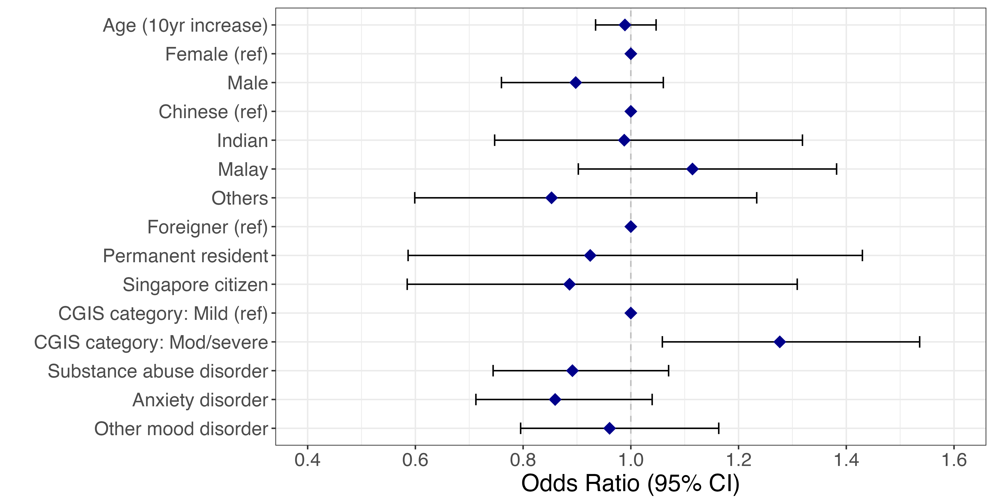
Results
Less likely to meet treatment standard
More likely to meet treatment standard

Slide 9





Summary & Interpretation
25%
Patients not meeting treatment standard
Potential for preventative intervention in primary care
More patients receiving antidepressants than therapy
Offer therapy at same time as antidepressants
Higher severity associated with treatment
Opportunity for adjunctive therapies?
Further research should work alongside domain area experts to understand the underlying care processes and clinical guidance relevant to the treatment of MDD.

Slide 10
Limitations
Unclear whether included episodes are from patients with an existing diagnosis of MDD.
No data on duration of condition.
Not all adjunctive therapies are included in clinical data.
Clinically relevant confounders and interactions may have been missed.

